Slide 1
BMS User Documentation
Where today meets tomorrow.
.
Unrestricted © Siemens 2020

Slide 2
Agenda: Folder Structure Explanation Closed Loop Simulation C-code generation Open Loop Simulation Hardware in Loop Simulation

Slide 3
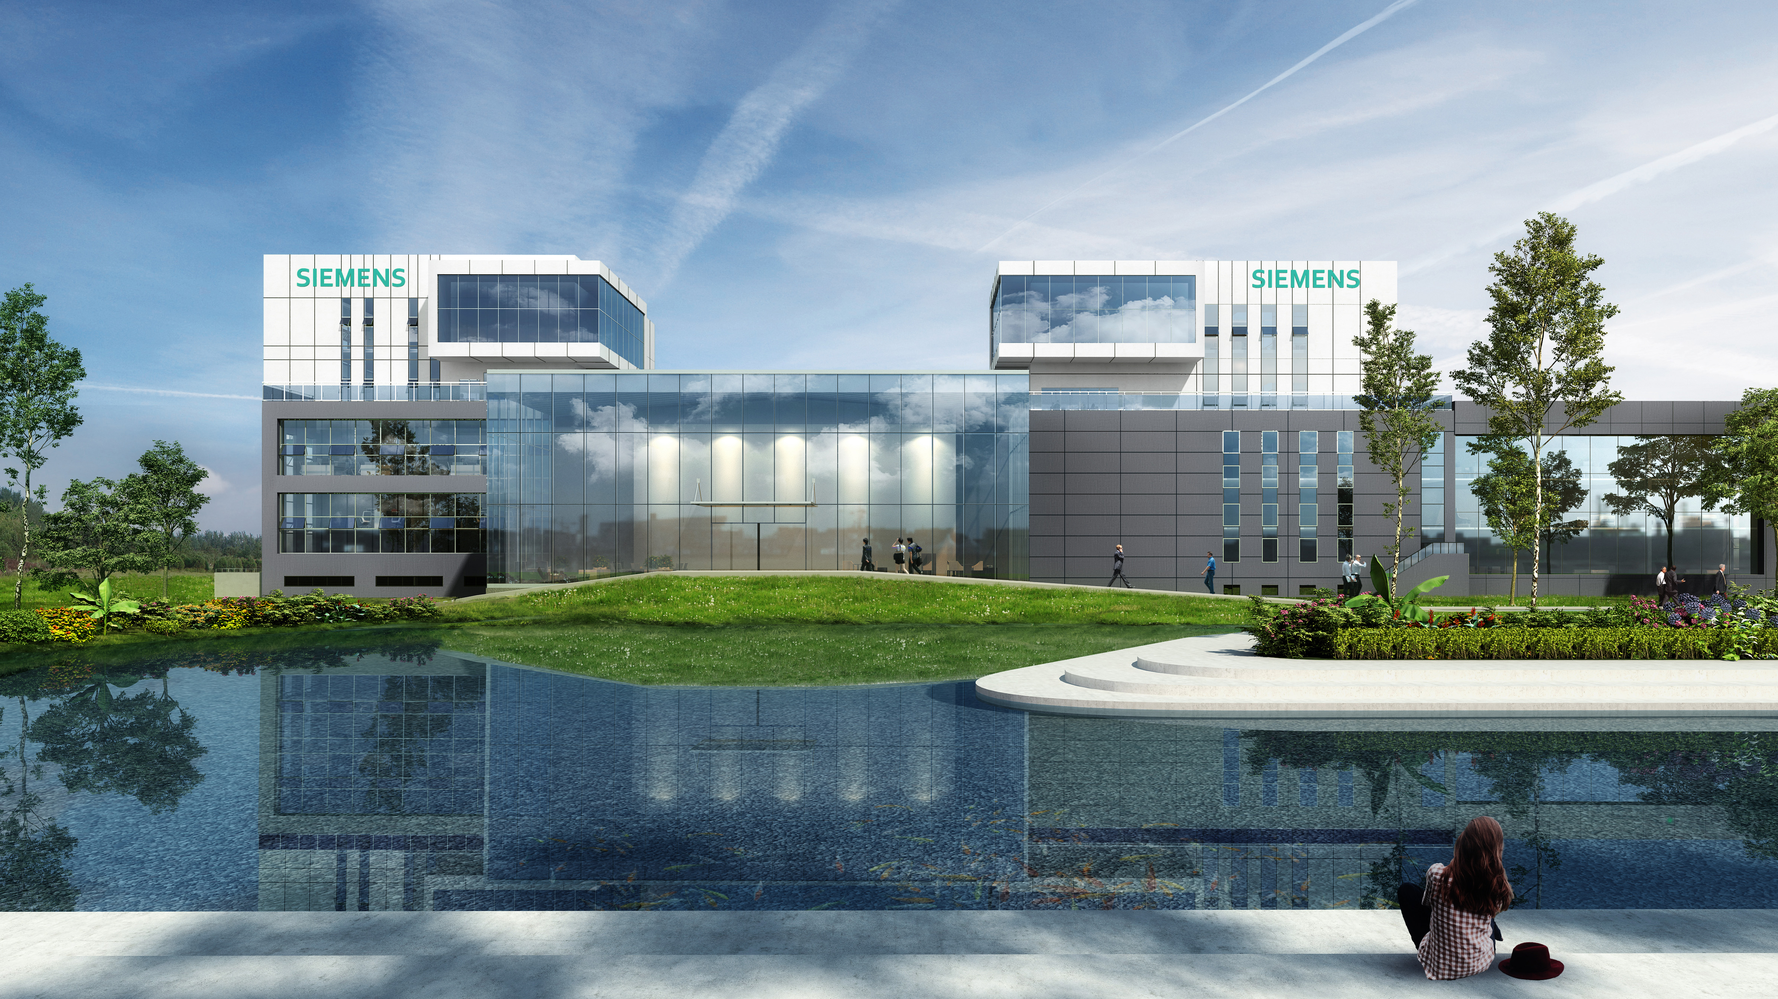
Folder Structure Explanation
Root Folder
Feature Folder
Model Folder
Application Folder

Slide 4
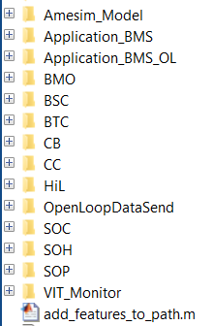
1. Folder Structure Explanation Root Folder
Amesim Battery Model [Model]
Closed Loop Harness [Application]
Open Loop Harness [Application]
Battery Mode [Feature]
Battery State Control [Feature]
Battery Thermal Control [Feature]
Cell Balancing [Feature]
Contactor Control [Feature]
Hardware in Loop Harness [Application]
Open Loop Data Send [Application]
State of Charge [Feature]
State of Health [Feature]
State of Power [Feature]
Voltage, Current and Thermal Monitoring [Feature]
Script to add features to Matlab path [Script]

Slide 5
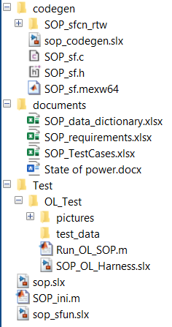
2. Folder Structure Explanation Feature Folder
Code generation folder
C-code generation Harness
Generated C-code
Generated C-code
Mex file from generated C-code
Documents related to Feature
Feature Data Dictionary
Feature Requirements
Feature Test Cases
Feature Documentation
Test Folder
Open Loop Test Folder [Some features can have a Closed Loop Test folder too]
Test cases
Script to run open loop test cases
Open loop test harness
Feature Model
Script to initialize feature
Feature model with mex file from generated C-code

Slide 6
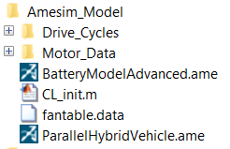
3. Folder Structure Explanation Model Folder
Amesim model folder
Drive cycle data
Motor data to Parallel Hybrid Vehicle model
Amesim battery model
Script to initialize Amesim model
Fan data for Battery Model Advanced model
Parallel Hybrid Vehicle Model

Slide 7
4. Folder Structure Explanation Application Folder
Each Application Folder will be explained in upcoming slides of each application.

Slide 8
Closed Loop Simulation
Folder Structure
Simulation Setup & Initialization
Running Simulation

Slide 9
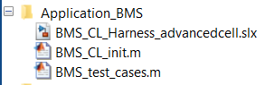
1. Closed Loop Simulation Folder Structure
Closed Loop Harness Application folder
Closed Loop Harness model
Script to initialize Closed Loop Harness
Script to initialize and select test cases

Slide 10
2. Closed Loop Simulation Simulation Setup & Initialization
Run ‘add_features_to_path.m’ in the root folder. This will add all the features to the Matlab path.
Go-to Model Folder and open ‘BatteryModelAdvanced.ame’. Move to Simulation tab in Amesim.
Open ‘BMS_test_cases.m’ and input the test case number in Line 1. Test Cases are defined in the final report. Save the script.
Open ‘BMS_CL_Harness_advancedcell.slx’.
Run ‘BMS_CL_init.m’ to initialize all the features and closed loop harness. (On running this script matlab working directory will change to Model Folder) Switching between Simulink blocks and c-code s-function:
Open ‘BMS_CL_init.m’ and scroll to bottom
You can change the variables ‘use_{feature_name}_sfun’ to 1 if you want to use c-code s-function or 0 to use Simulink blockset.

Slide 11
3. Closed Loop Simulation Running Simulation
Switch to ‘BMS_CL_Harness_advancedcell.slx’ window.
Click on Run and the simulation will start. You can see the results as the simulation is running in Amesim.
Once the simulation is over all the results will be available in the matlab workspace as timeseries objects.

Slide 12
C-code generation
Folder Structure
Generating C-code
Testing C-code

Slide 13
1. C-code generation Folder Structure
Code generation folder
C-code generation Harness
Generated C-code
Generated C-code
Mex file from generated C-code
Each feature folder has a code generation folder as shown.
Feature Model
Feature model with mex file from generated C-code

Slide 14
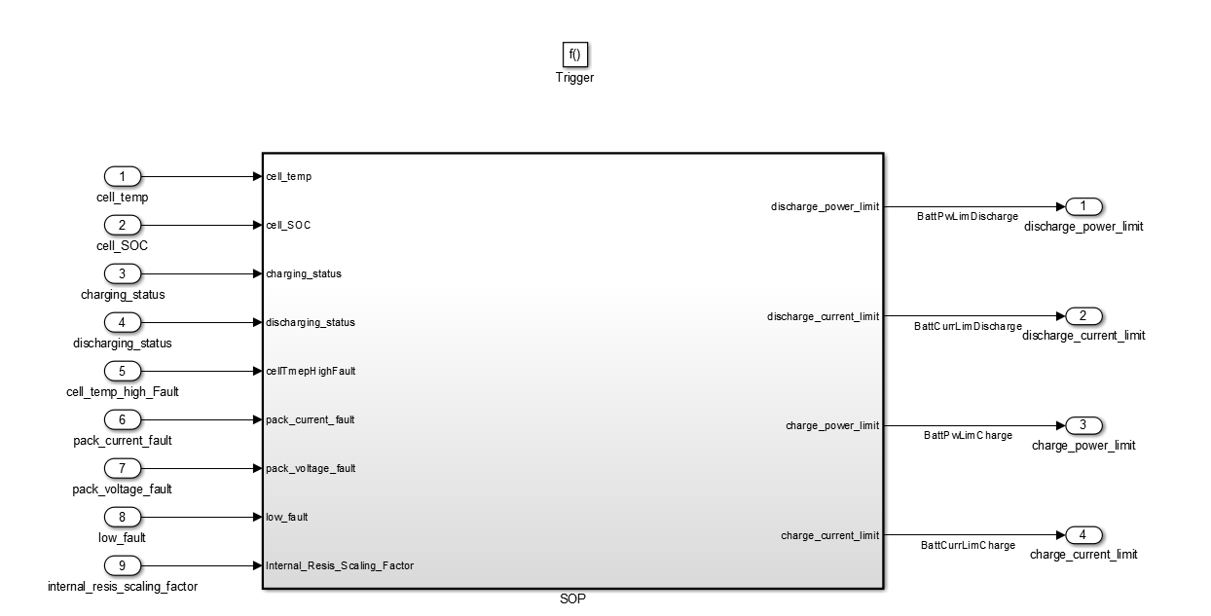
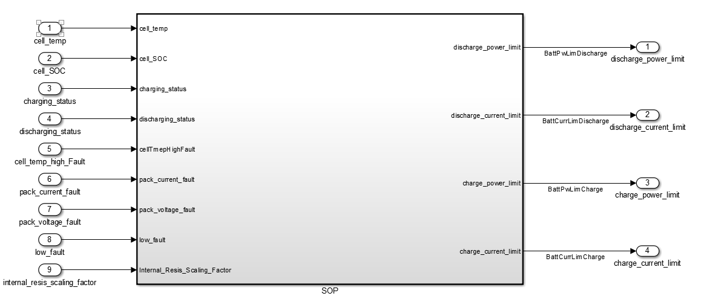
2.1 C-code generation Generating C-code
Open the feature model Simulink file. (e.g sop.slx)
Open the C-code generation harness. (e.g sop_codegen.slx)
Copy only the feature subsystem from Simulink model file and paste it into the C-code generation harness. (Do not copy and paste the input/output ports)
sop.slx
sop_codegen.slx
Copy & Paste

Slide 15
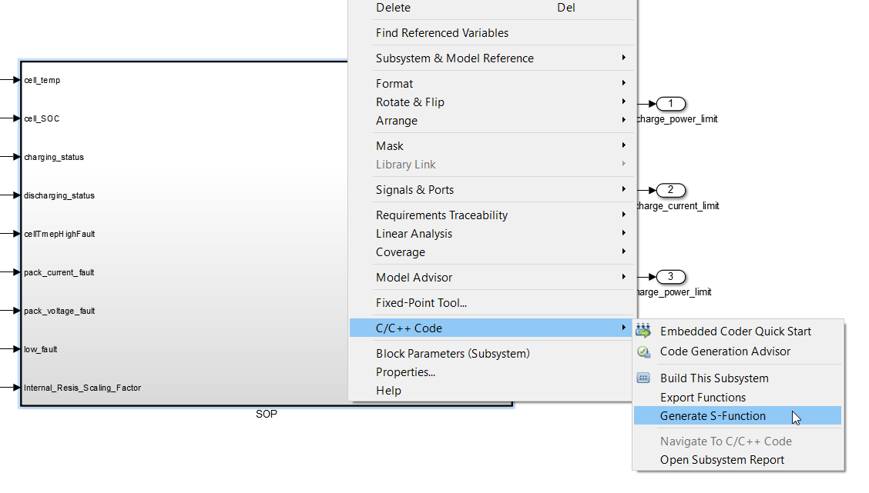
2.2 C-code generation Generating C-code
Make your current working directory as the codegen folder.
Right click the feature subsystem in C-code generation harness, go-to ‘c/c++ code’ and click ‘Generate S-function’.
Select the tunable variables and click ‘Build’.
This will generate the c-code in the codegen folder and the mex file. The mex file is already being used in {feature}_sfun.slx file. (e.g sop_sfun.slx) This is used to test the generated c-code in desktop itself.

Slide 16
3. C-code generation Testing C-code
C-code can be tested in desktop using the closed loop harness application or open loop harness application.
In slide ‘2. Closed Loop Application : Simulation Setup and Initialization, Point 4’, steps are given how to use s-function which uses the generated mex file from the c-code.
In slide ‘2. Open Loop Application : Simulation Setup and Initialization, Point 3’, steps are given how to use s-function which uses the generated mex file from the c-code.

Slide 17
Open Loop Simulation
Folder Structure
Simulation Setup & Initialization
Running Simulation

Slide 18
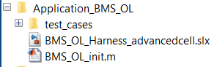
1. Open Loop Simulation Folder Structure
Open Loop Harness Application folder
Test Case data from Closed Loop Harness
Open Loop Harness model
Script to initialize Open Loop Harness

Slide 19
2. Open Loop Simulation Simulation Setup & Initialization
Run ‘add_features_to_path.m’ in the root folder. This will add all the features to the Matlab path.
Open ‘BMS_OL_Harness_advancedcell.slx’.
Run ‘BMS_OL_init.m’ to initialize all the features and open loop harness.
Switching between Simulink blocks and c-code s-function:
Open ‘BMS_OL_init.m’ and scroll to bottom
You can change the variables ‘use_{feature_name}_sfun’ to 1 if you want to use c-code s-function or 0 to use Simulink blockset.
Changing test case
Open ‘BMS_OL_init.m’
At the top you can enter the test case number.

Slide 20
3. Open Loop Simulation Running Simulation
Switch to ‘BMS_OL_Harness_advancedcell.slx’ window.
Click on Run and the simulation will start.
Once the simulation is over all the results will be available in the matlab workspace as timeseries objects.

Slide 21
Hardware in Loop Simulation
Folder Structure
Simulation Setup
Simulation Initialization
Running Simulation

Slide 22
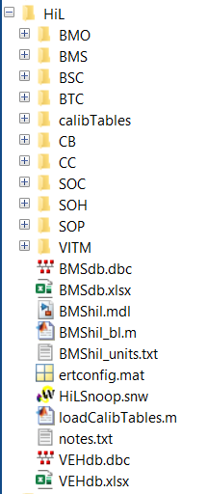
1.1 Hardware in Loop Simulation Folder Structure
Calibration Tables
Feature Folders with Data Dictionary in OpenECU format inside it
BMS Internal CAN Database and Excel file
HiL Simulink Model
OpenECU required m-file which adds feature folders
OpenECU required file which holds all the allowed units
Model Configuration for Embedded Coder. All Simulink models use this config
PiSnoop Project for Hardware in Loop
m-script to load calibration tables
Vehicle CAN Database and Excel file

Slide 23
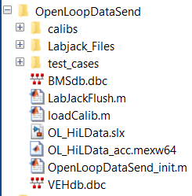
1.2 Hardware in Loop Simulation Open Loop Data Send Folder Structure
Calibration Files
Files related to LabJack Communication
Saved Test Cases
BMS Internal CAN database
m-file which should be run after every simulation. Resets Labjack ports
m-file to load calibration files
Simulink file to send/receive data to PiInnovo M110
Mex file on building the model in Accelerated mode
m-file to initialize the Simulink model
Vehicle CAN database

Slide 24
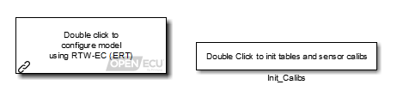
2.1 Hardware in Loop Simulation Simulation Setup
Run ‘add_features_to_path.m’ in the root folder. This will add all the features to the Matlab path.
Hardware block diagram is shown in the final report and is also available in the documents folder. Setup the hardware according to it and pin-mapping present in the documents.
Open ‘BMShil.mdl’. This will also load all the data dictionaries and calibration tables.
Incase data dictionaries and calibration tables are to be loaded again, then there 2 block in the model which can be double clicked to load respective data.
This model has all input/output blocks for PiInnovo along with BMS controller with model referenced features.
Hit ‘Build’ to generate the ‘.hex’ and ‘.a2l’ file. ‘.hex’ is the binary file which will be updated to PiInnovo M110 and ‘.a2l’ is used to monitor signals and change calibration if needed.

Slide 25
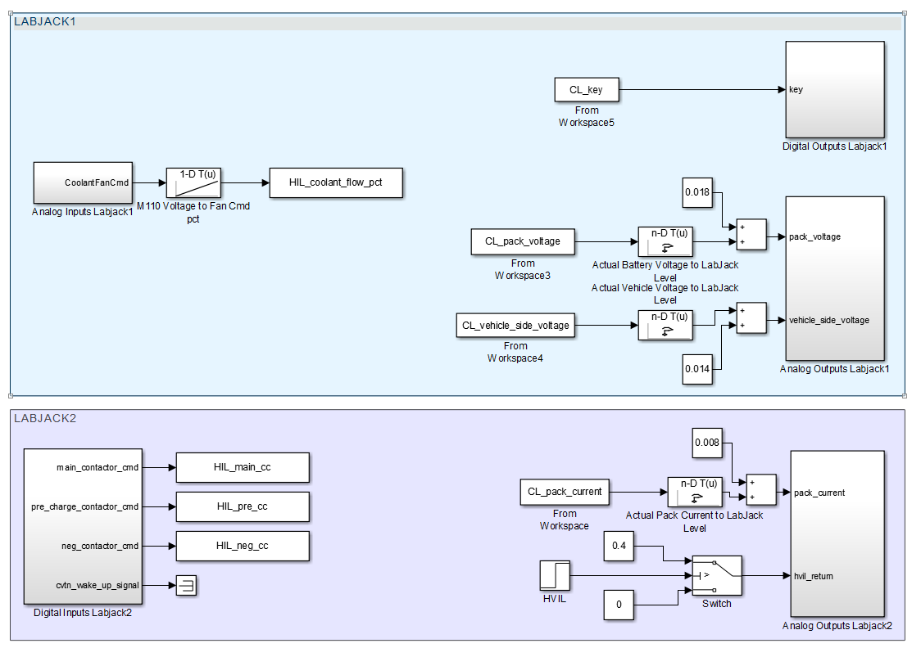
2.2 Hardware in Loop Simulation Open Loop Data Send Simulation Setup
This Simulink model will send and receive data from PiInnovo M110. Make sure the 2 LabJacks and 2 Kvaser USBCAN are connected to the computer. Open a new Matlab Session for this model.
Open ‘OpenLoopDataSend_init.m’. Enter the test number in the m-file and run the file.
Open ‘OL_HiLData.slx’.
Goto each of the blocks shown and perform the following steps: [Required only once]
Open the block and the matlab function inside it.
Update the ‘sno’ variable to the corresponding Labjack serial number.
Compile the model ‘Ctrl + D’ to make sure no files are missing.
Run ‘LabJackFlush.m’ and check that no error comes up. This confirms communication with both the LabJack’s is available.

Slide 26
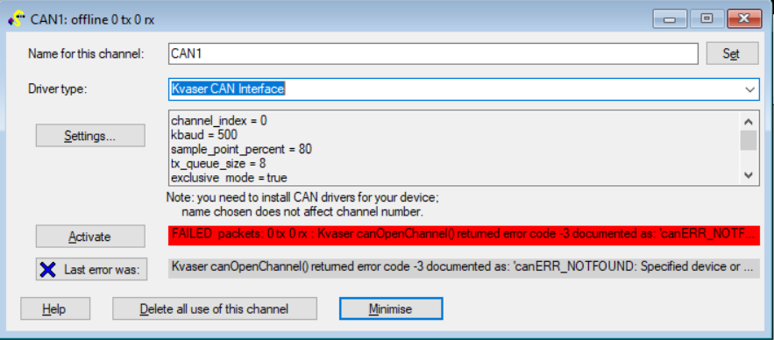
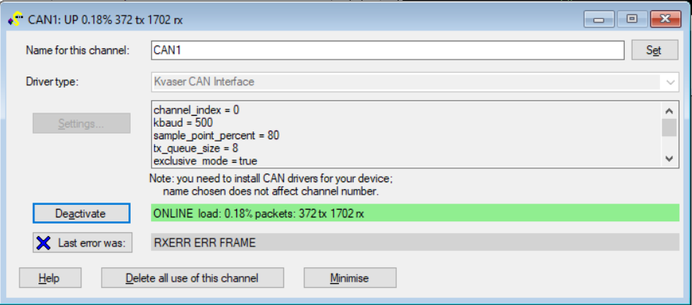
3.1 Hardware in Loop Simulation Simulation Initialization
Open PiSnoop software.
Open ‘HILSnoop.snw’ project.
Click ‘Activate’ in CAN1 block as shown. On successful connection the block will show ‘Online’

Slide 27
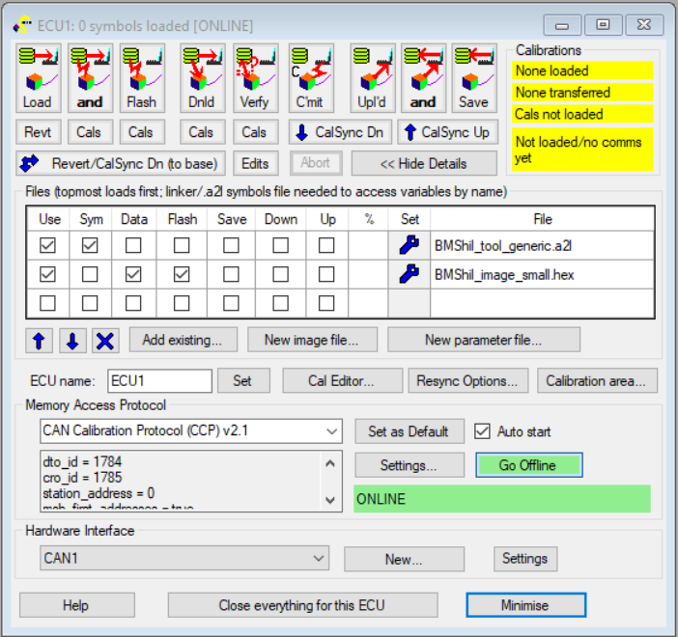
3.2 Hardware in Loop Simulation Simulation Initialization
Make sure the files are same as shown in ECU1 block.
Click ‘Load and Flash’ button as shown to upload the code to PiInnovo M110. Wait for the flashing process to complete.
Load and Flash

Slide 28
4 Hardware in Loop Simulation Running Simulation
Run ‘LabJackFlush.m’ to reset LabJack pins. Both the LabJack’s will flash light for a second.
Switch off ECU after flashing is complete and switch it ON.
Run the OL_HiLData.slx to send the data to M110. When the Simulation is complete results are available in the workspace.
Once the simulation is complete run ‘LabJackFlush.m’. Now you can switch off ECU and switch on ECU to run another test.
Note: If ‘LabJackFlush.m’ is not run then Labjack would send wrong data to M110 initially.

Slide 29
Hardware in Loop Simulation using only CAN
Folder Structure
Simulation Setup
Simulation Initialization
Running Simulation

Slide 30
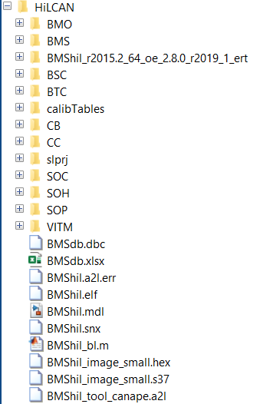
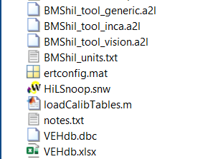
1.1 Hardware in Loop Simulation using only CAN Folder Structure
Embedded Coder build files
Calibration Tables
Feature Folders with Data Dictionary in OpenECU format inside it
BMS Internal CAN Database and Excel file
HiL Simulink Model
OpenECU required m-file which adds feature folders
Hex file to be used in PiSnoop
.a2l file to be used in PiSnoop
OpenECU required file which holds all the allowed units
Model Configuration for Embedded Coder. All Simulink models use this config
PiSnoop Project for Hardware in Loop
m-script to load calibration tables
Vehicle CAN Database and Excel file

Slide 31
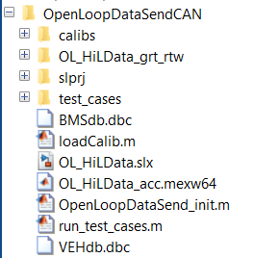
1.2 Hardware in Loop Simulation using only CAN Open Loop Data Send Folder Structure
Calibration Files
Build files related to accelerated build of model
Saved Test Cases
BMS Internal CAN database
m-file to load calibration files
Simulink file to send/receive data to PiInnovo M110
Mex file on building the model in Accelerated mode
m-file to initialize the Simulink model
m-file to run test cases in a loop indefinitely
Vehicle CAN database

Slide 32
2.1 Hardware in Loop Simulation using only CAN Simulation Setup : Not needed as model is already built
Run ‘add_features_to_path.m’ in the root folder. This will add all the features to the Matlab path.
Hardware block diagram is shown in the final report and is also available in the documents folder. Setup the hardware according to it and pin-mapping present in the documents.
Open ‘BMShil.mdl’. This will also load all the data dictionaries and calibration tables.
Incase data dictionaries and calibration tables are to be loaded again, then there 2 block in the model which can be double clicked to load respective data.
This model has all input/output blocks for PiInnovo along with BMS controller with model referenced features.
Hit ‘Build’ to generate the ‘.hex’ and ‘.a2l’ file. ‘.hex’ is the binary file which will be updated to PiInnovo M110 and ‘.a2l’ is used to monitor signals and change calibration if needed.

Slide 33
2.2 Hardware in Loop Simulation using only CAN Open Loop Data Send Simulation Setup
This Simulink model will send and receive data from PiInnovo M110. Make sure the Kvaser CAN is connected to the computer. Open a new Matlab Session for this model.
Open ‘OL_HiLData.slx’.
Compile the model ‘Ctrl + D’ to make sure no files are missing.

Slide 34
3.1 Hardware in Loop Simulation using only CAN Simulation Initialization
Open PiSnoop software.
Open ‘HILSnoop.snw’ project.
Click ‘Activate’ in CAN1 block as shown. On successful connection the block will show ‘Online’

Slide 35
3.2 Hardware in Loop Simulation using only CAN Simulation Initialization
Make sure the files are same as shown in ECU1 block.
Click ‘Load and Flash’ button as shown to upload the code to PiInnovo M110. Wait for the flashing process to complete.
Once the pop-up comes up go ‘Offline’ and ‘Deactivate’ CAN
Load and Flash

Slide 36
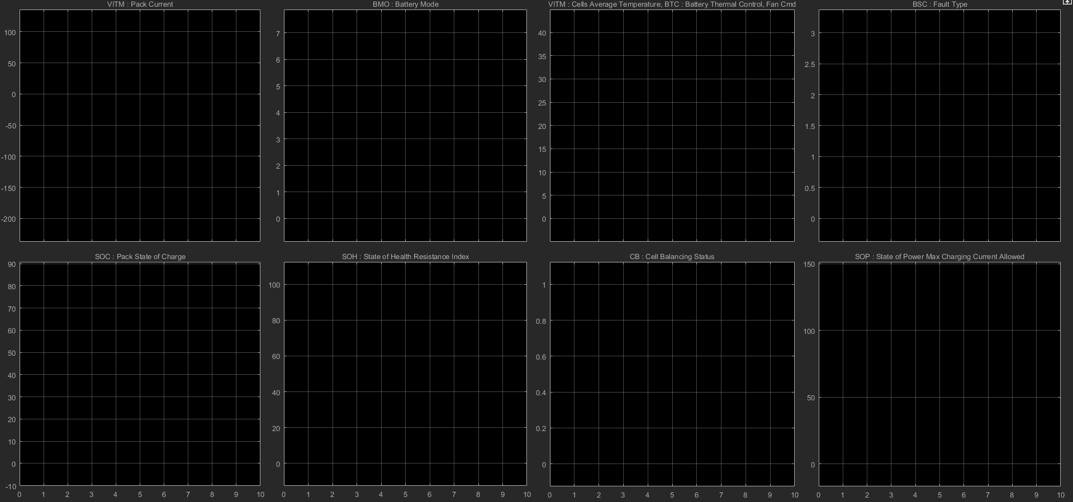
4 Hardware in Loop Simulation using only CAN Running Simulation
Switch off ECU after flashing is complete and switch it ON. [Power Supply]
Run the run_test_cases.m to send the data to M110. When the Simulation starts a scope with 8 graphs will open as shown below.
To stop, hit Ctrl+C in Matlab command window.

